Slide 1
Climate Change. (REAL STORY) Correlate City Temperature Data - With Green Energy Initiatives adopted by City.
Roy Mammen
Nov 26th

Slide 2
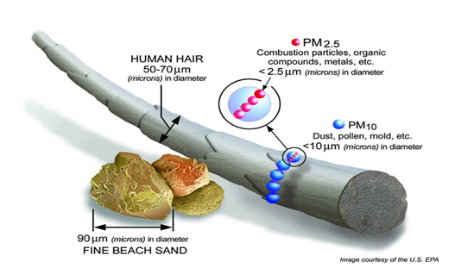
Select Topic
Can we predict weekly mean temperature of Cities, given
Air Quality Indicator (AQI)
i)SO2 ii)NO2 iii)CO iv)PM2.5 v)PM10
Population
City Location
Wind Speeds
Time of Year

Slide 3
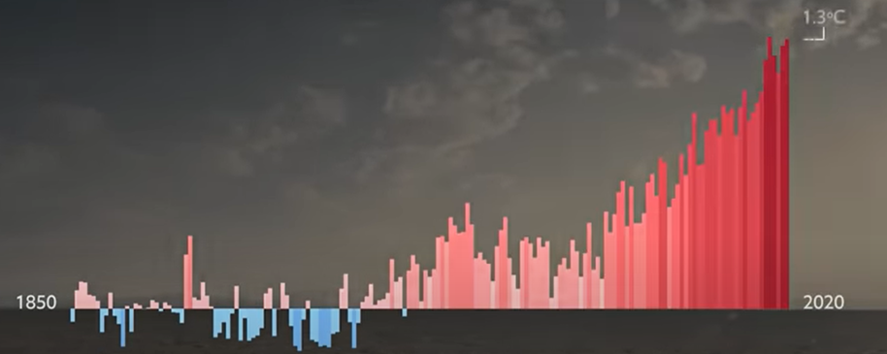
Reason For Topic Selection
Global Warming is a reality & showing as natural calamities, world-wide.
How to educate ourselves further with examples and ML. (Or is it complex?)
Select few metropolitan cities in Northern and Souther Hemispheres.
See if average Temperature in these cities are trending high?
Is reduced greenhouse gasses really helping reduce city temperature Trends?
Conclude if Green Energy initiative is helping reduce mean temperature in a city?
Assumption : Air quality Indicator should reflect – Green energy Initiatives.

Slide 4
Source of Data
City temperature Kaggle Data.
United States Environmental Protection Agency – Data sets
Data & Data Products: Draft API Strategy | US EPA
Air Data: Air Quality Data Collected at Outdoor Monitors Across the US | US EPA
Download Daily Data | US EPA
US Census Bureau and other Population Data sets
Activity : Download, Clean, Visualize data, from these trusted source.

Slide 5
Analysis Phase
Isolated 4 cities for this project :
Los Angeles, CA
London, Great Britain
Sydney, Austrailia
Brasilia, Brazil
Difficulty to collect valid data from several locations, plus time involved in cleaning data, it was decided to restrict to Los Angeles.
Once data was downloaded, following visualizations helped confirm correlation.

Slide 6
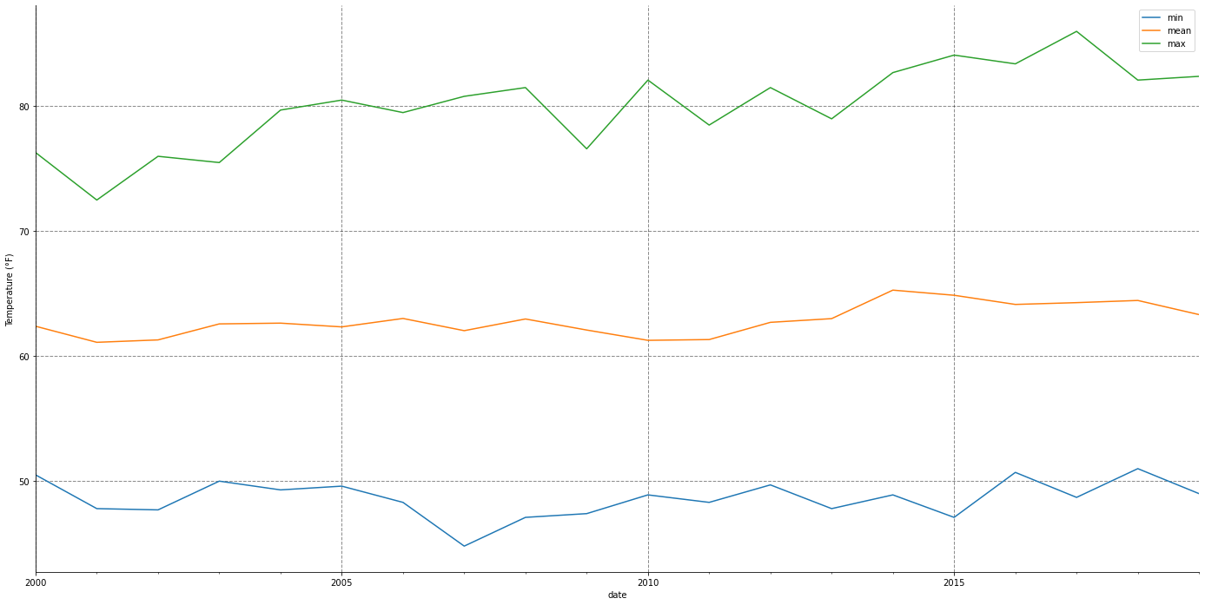
Analysis Phase : Inspect trends correlation.
Los Angeles city Temperature highs Year over Year.

Slide 7
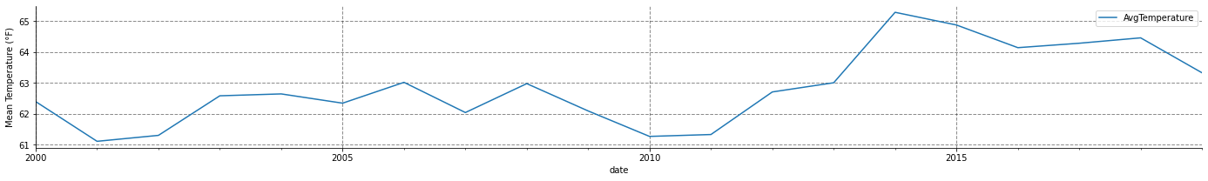
Initial Analysis Mean City Temperature.
Los Angeles city Temperature highs Year over Year.
Notes:
2001-02 and 2008-10 decreased mean temperature. Correlates to lower stockmarket index.
2020-2021 decreased mean temperature Correlates to lockdown during pandemic

Slide 8
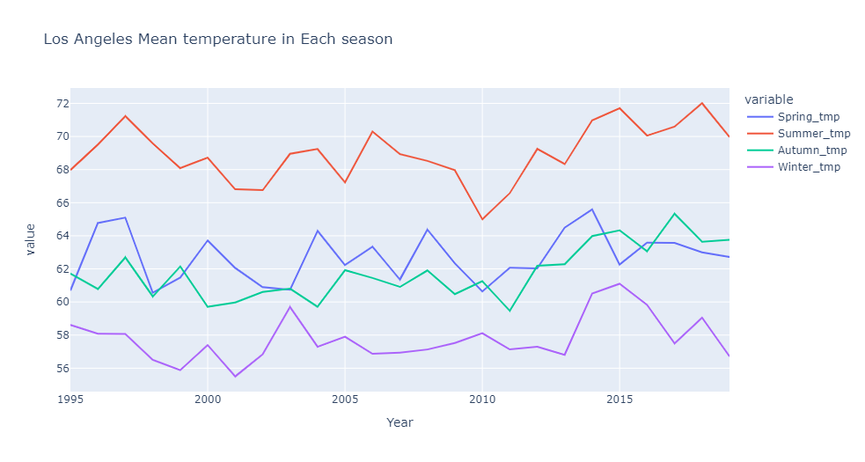
Analysis Phase : Seasonal Highs Year over Year
Spring, Summer, Fall Winter Increase trends in Temperature
Notes:
As we can see there is a strong correlation with health of economy and/or stock market index. Example 2002-03 and 2008-10 time-frame for a period of recession
Also 2020-2021 the downward trend is related to lockdown and decreased human activity doing un-necessary driving around

Slide 9
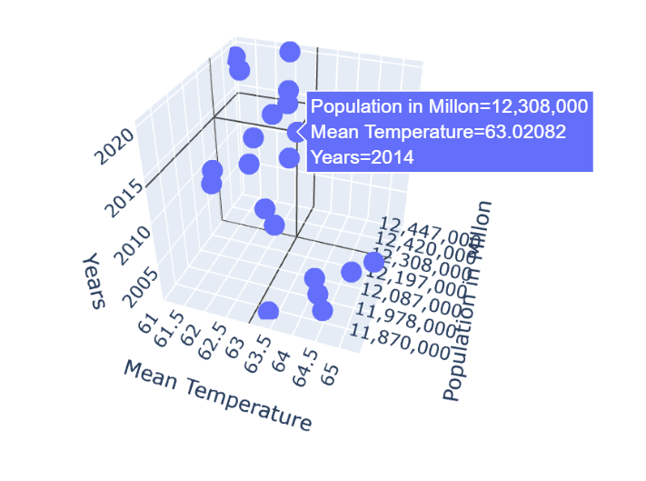
Analysis Phase : Inspect trends correlation.
3D Plot of Temperature variation vs Population Y o Y

Slide 10
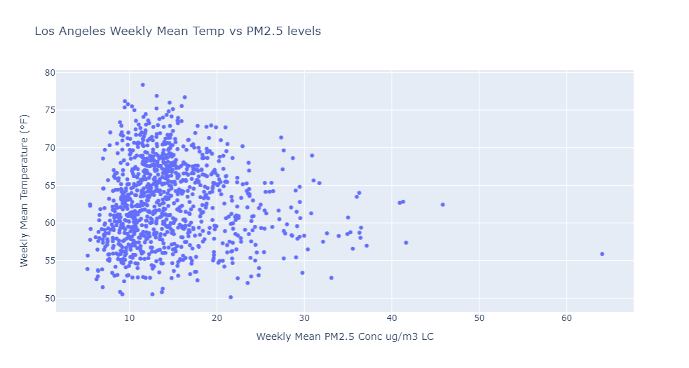
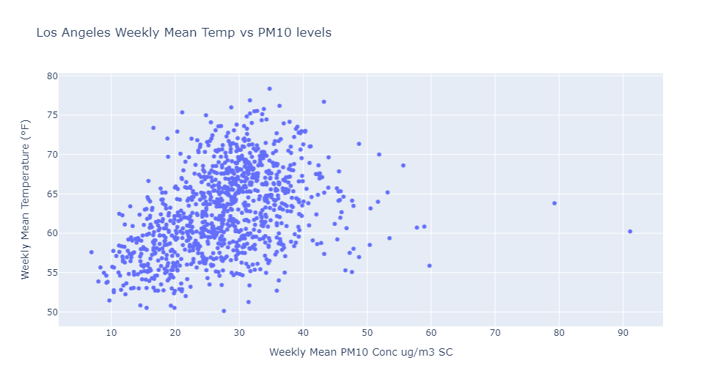
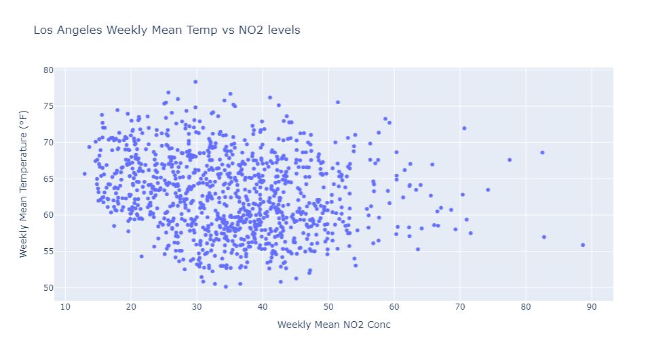
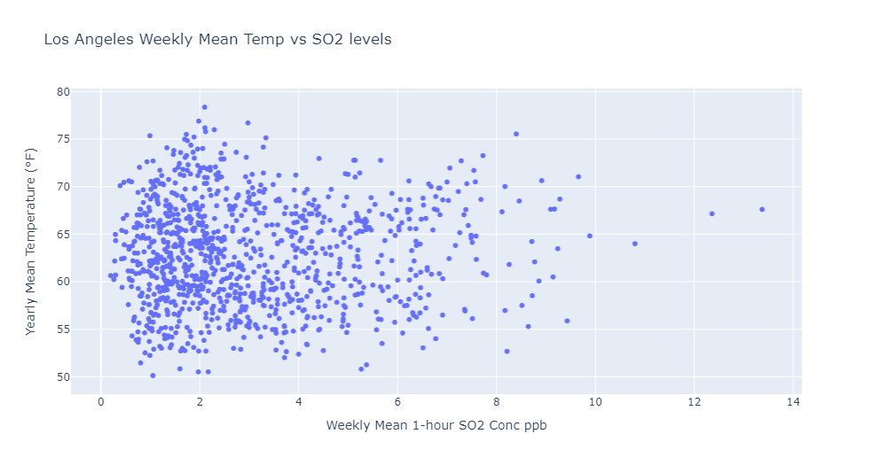
Analysis : Temperature Correlation with Air Quality
Air Quality PM2.5, PM10, NO2 and SO2

Slide 11
Technologies Languages Tools Used
Technologies/Languages
Python/Pandas/MathPlotLib
SQL
Flask/HTML
Tools
VS Code
Jupyter NoteBook
PostgressSQL
Machine Learning - RandomForestRegressor

Slide 12
Machine Learning Process
Data processing: Pandas techniques/Spreadsheets/APIs
Feature Selection/Explanation of model:
Phase#1: RandomForestRergerssor
Reason to take this approach was to first establish city temperature trends given qir quality indicator, population growth and geographic location
This way model should predict the outcome of a given sample when the output variable
Phase#2: Integrate more cities establish trends.
Inspect if we can prevent and reverse higher temperature trends?
Training of Model
80/20 split of cleaned data was used.
Use the training data to find the values of coefficients b0/b1 to make reasonable predictions for future.

Slide 13
Challenges
Difficulty finding Data related to green energy initiatives.
Finding reliable data for AQI indicators took more time than normal.
Validating data was a good approach before integrating into ML Model.
Some time was lost while looking for sufficiently clean data on cities.
Cities were identified in phase-1, with high population and sufficient AQI data availability.
Lack of time/Time management issues.

Slide 14
Enhancements
Add/integrate wind speed data to Los Angeles ML model.
Add integrate Unemployment index to model for better correlation.
Decreased human activity during overall high unemployment, decreased temperature.
Decreased human activity during pandemic period.
Integrate more cities, at least two more in
Northern Hemisphere
Southern Hemisphere
Key findings in increased human activity should show up with other cities as well.
Find City Air conditioner/Refrigerator use data and integrate into ML model
Correlate amount of meat consumption, daily per capita to see if there is a correlation.
Automation by Integrate APIs

Slide 15
Strong Correlation With Jobs & City Temperature.
Los Angeles city Temperature highs Year over Year.
Notes:
2001-02 and 2008-10 decreased mean temperature. Correlates to lower stockmarket index.
2020-2021 decreased mean temperature Correlates to lockdown during pandemic

Slide 16
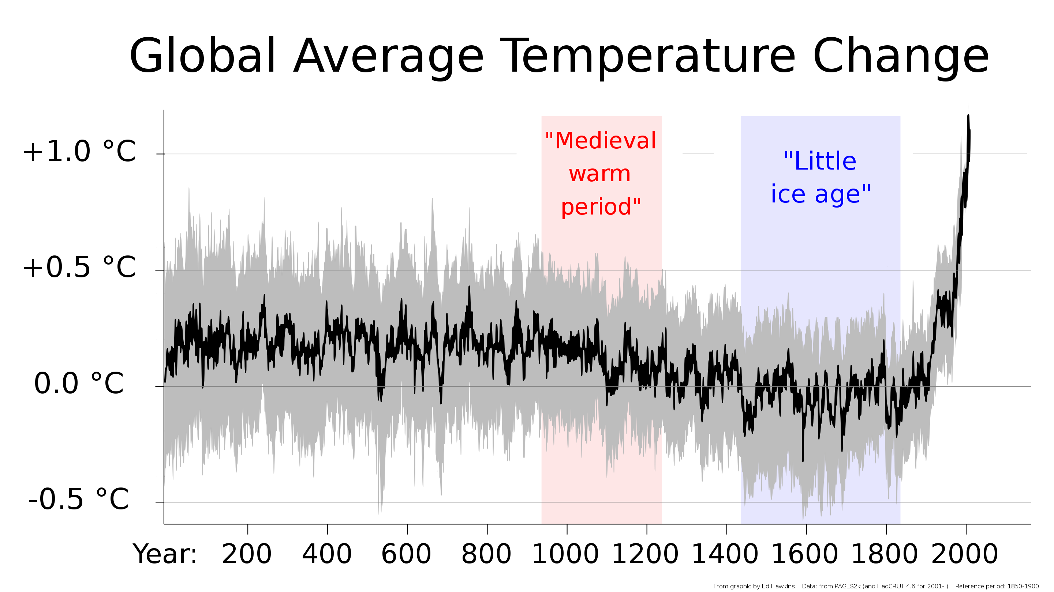
Conclusion
Green Energy initiatives may be helping!!
Los Angeles mean temperature shows a rising trend & contributing to global climate change.
We have to self regulate on energy usage.
switch to more greener alternatives
reduce dependence on energy.
Human activity factors strong indications
2002-03, 2008-10 Decrease in Los Angeles mean
temperature. Correlates with high unemployment
2020-2021 Decrease in Los Angeles mean temperature.
Correlates - lockdown during pandemic
Drive only for good reason.
Work more from home for sake of our kids!

